Slide 1



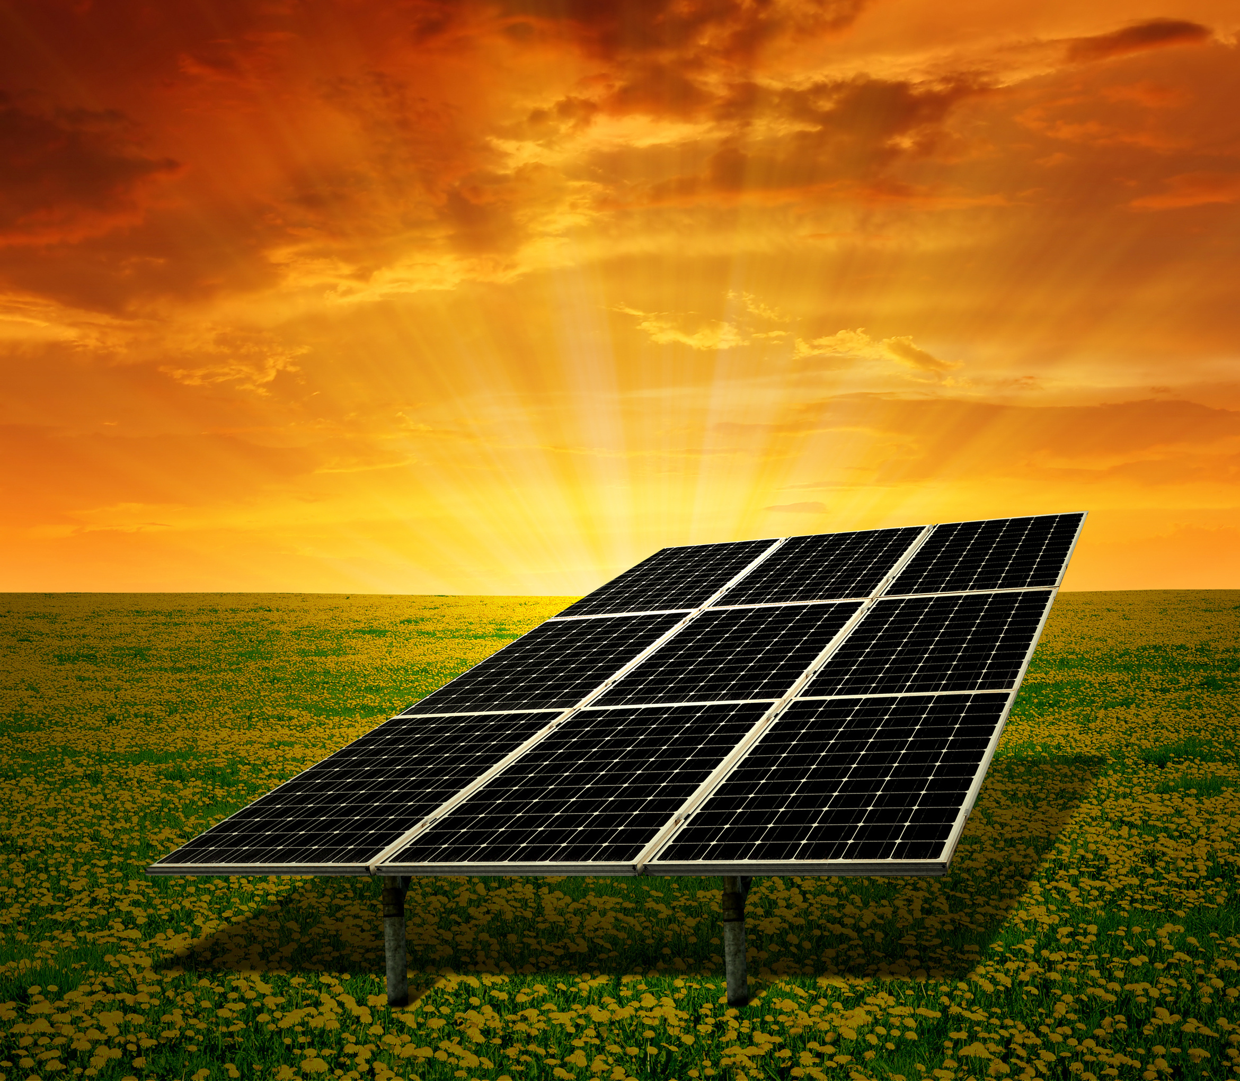



IOT & DATA ANALYTICS
Solar Monitoring & Tracking 360
PRESENTATION
2024
IOT 439 - Final Project

Slide 2
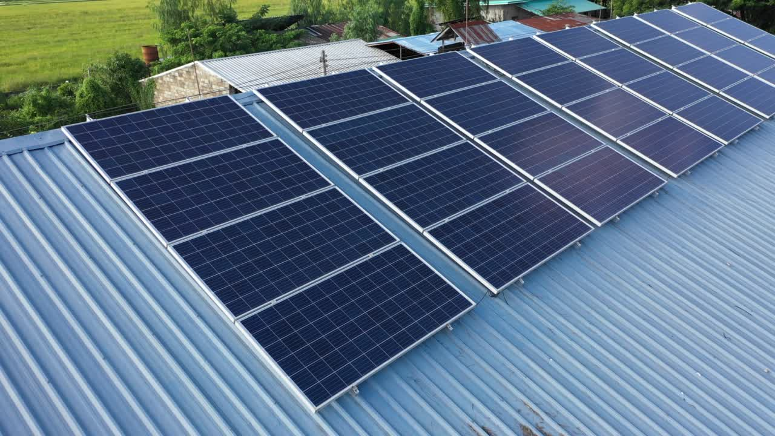
Team 3 Dot
211-16-557 (Farhan Sourav)
211-16-560 (Syed Nesar Haider)
211-16-569 (Sanaullah Efte Sani)

Slide 3

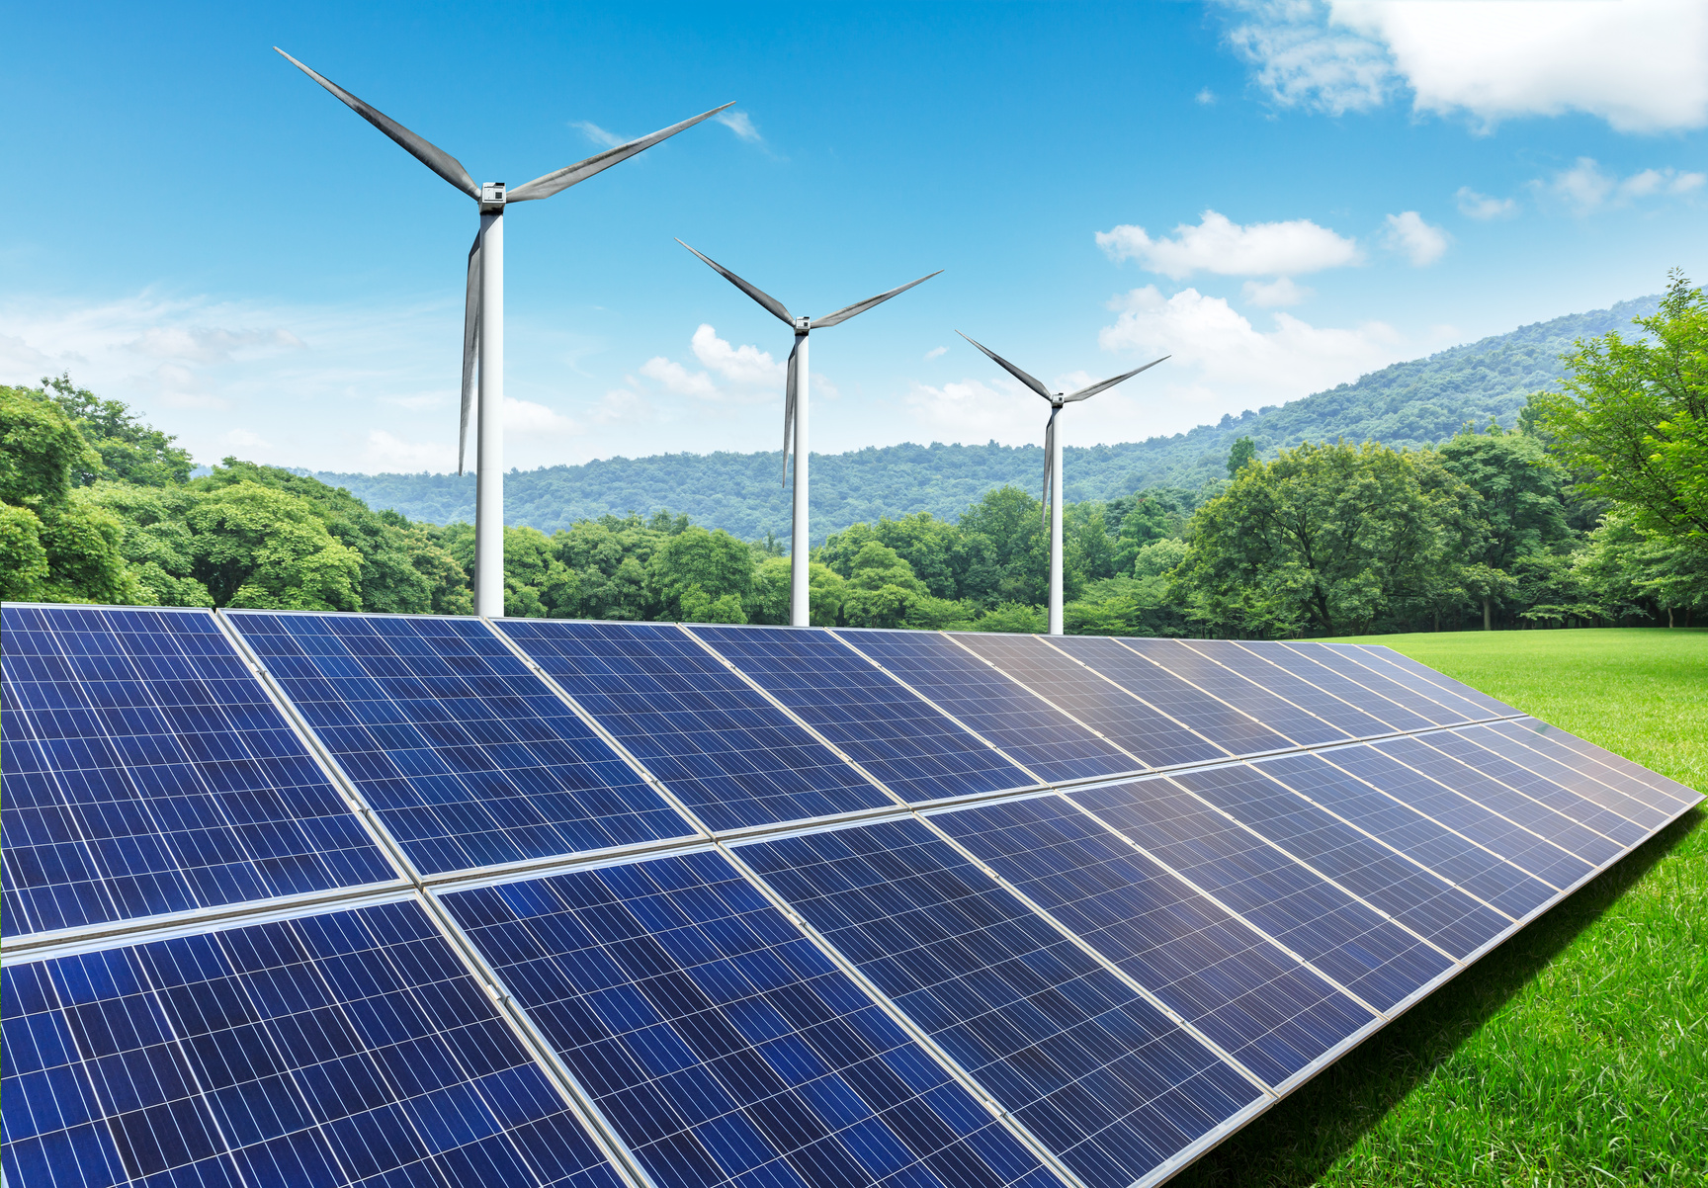

INTRODUCTION
Solar energy is a very large, inexhaustible source of energy.
Solar is the world's most popular form of new electricity generation The power from the sun intercepted by the earth is approximately 1.8 x 1011 MW Solar energy

Slide 4
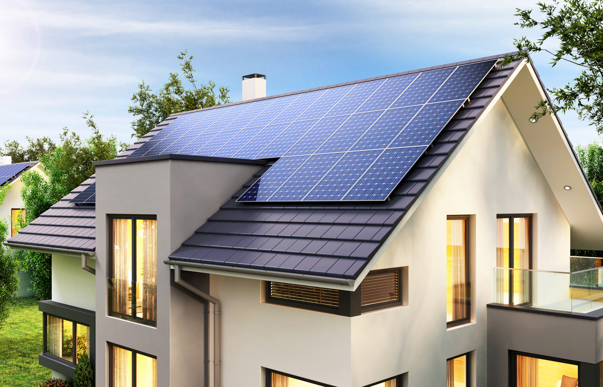
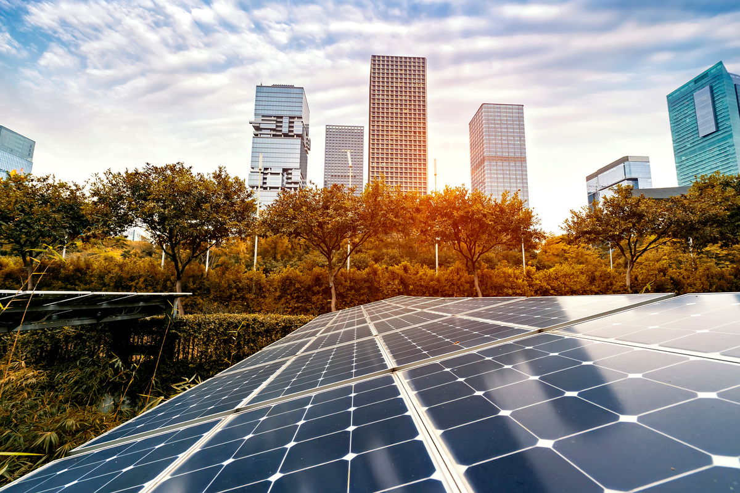
VISION & MISSION
Vision:
"Develop a smart solar panel system integrated with IoT technology
Mission:
"To create an intelligent solar panel system leveraging IoT to maximize energy efficiency.

Slide 5
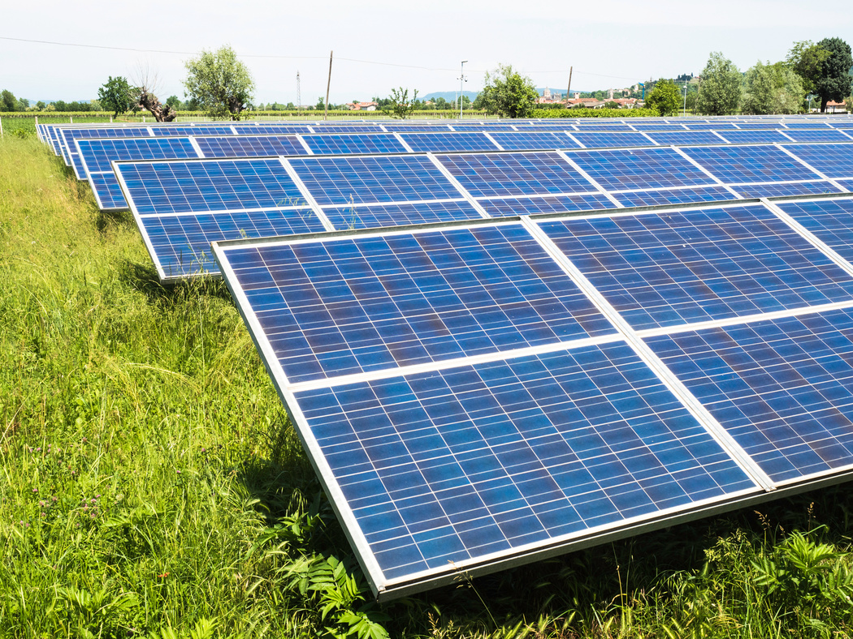
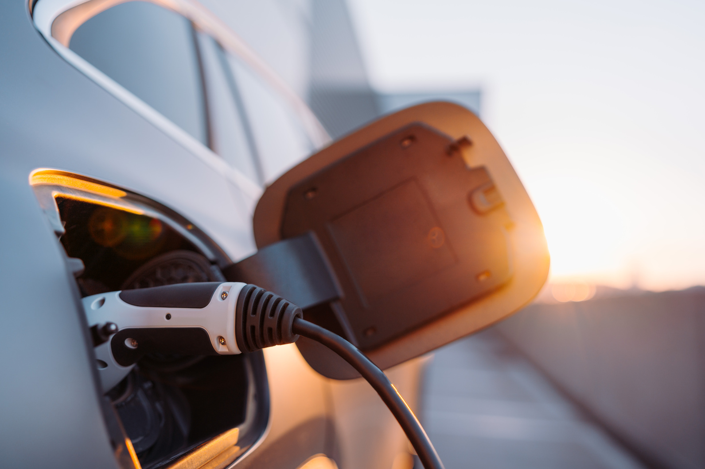
OUR HISTORY IN GREEN ENERGY
Solar trackers are devices used to orient photovoltaic panels, reflectors, lenses or other optical devices toward the sun. Ponjest Background 5 Solar Tracker Since the sun's position in the sky changes with the seasons and the time of day, trackers are used to align the collection system to maximize energy production. Solar trackers are of two types, single and dual axis trackers.

Slide 6
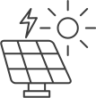
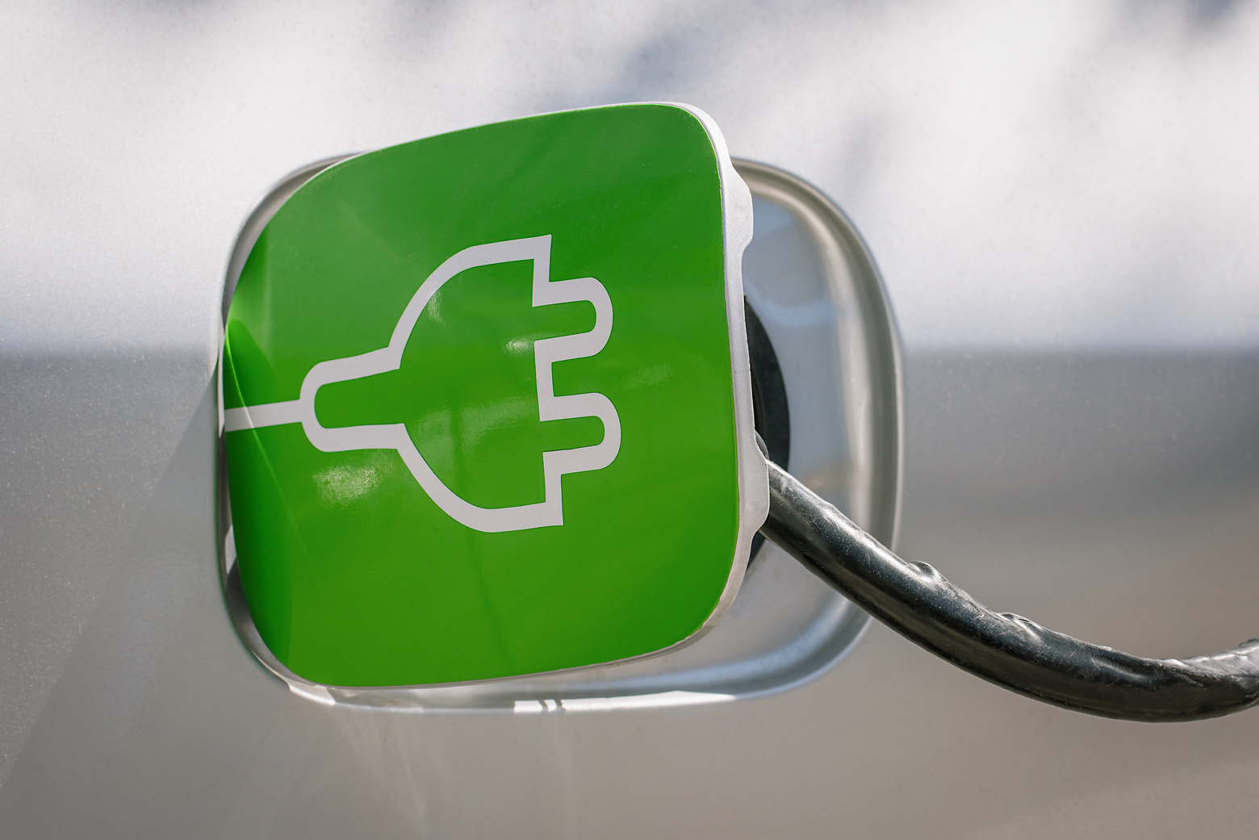


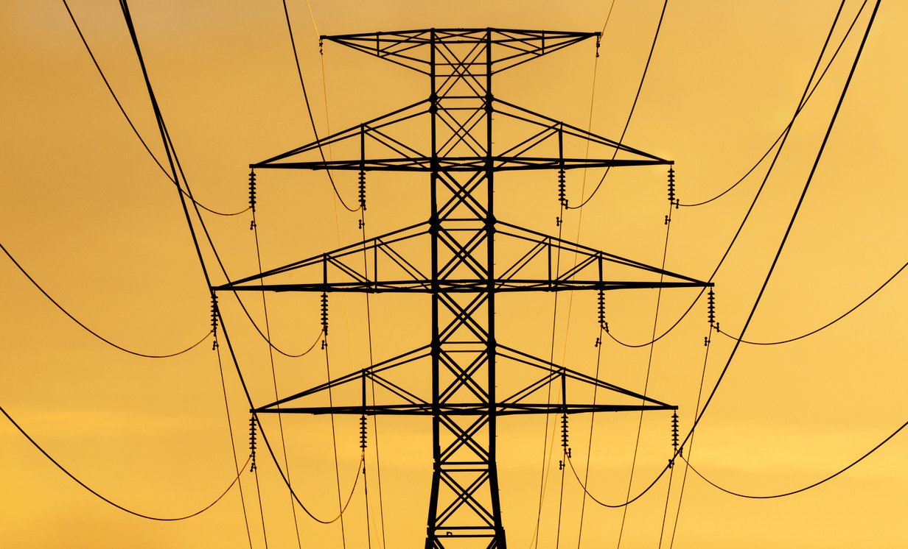
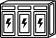
GREEN ENERGY SOLUTIONS
SOLAR ENERGY:
High-efficiency solar panels and photovoltaic systems for residential, commercial, and industrial use.
WIND ENERGY:
Advanced wind turbines and wind farms designed for optimal energy capture and minimal environmental impact.
HYDROELECTRIC POWER:
Innovative hydroelectric systems harnessing the power of water to generate clean energy.
BATTERY STORAGE:
Cutting-edge battery storage solutions ensuring reliable and efficient energy distribution.

Slide 7





BENEFITS OF GREEN ENERGY
Environmental Impact:
Reduction in greenhouse gas emissions
Preservation of natural resources
Economic Advantages:
Job creation in the renewable energy sector
Long-term cost savings for consumers and businesses
Health Benefits:
Improved air quality
Reduction in health issues related to fossil fuel pollution

Slide 8
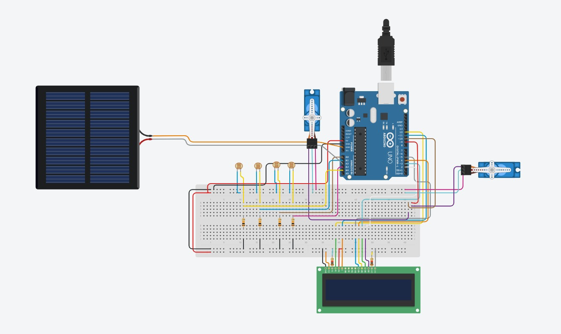
CIRCUIT DIAGRAM

Slide 9
Two LDR's (Light Dependent Resistor) LDR1 & LDR2 are connected to Analog pins of the Arduino. A solar plate is attached in parallel to the axis of the servo motor and both the sensors are kept on the solar plate. LDRs detect Sunlight and they send a signal to the Arduino, It will guide two Servo Motors to better place the solar panel to maximize its efficiency. The design & the arrangement is done in such a manner that the movement of the sun is from LDR1 to LDR2, as shown in the image below.
WORKING PRINCIPLE

Slide 10
HARDWARE COMPONENT
Quantity | Component | Component
1 | LCD 16 x 2 | LCD 16 x 2
1 | Arduino Uno R3 | Arduino Uno R3
2 | 1 kΩ Resistor | 1 kΩ Resistor
4 | Photoresistor | Photoresistor
4 | 10 kΩ Resistor | 10 kΩ Resistor
2 | Positional Micro Servo | Positional Micro Servo
1 | 5 V, 100 mA Solar Cell | 5 V, 100 mA Solar Cell

Slide 11
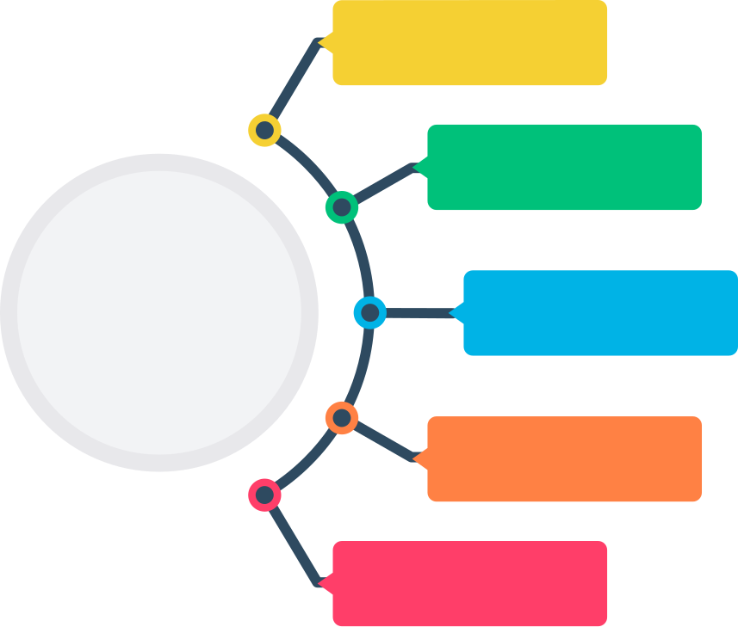
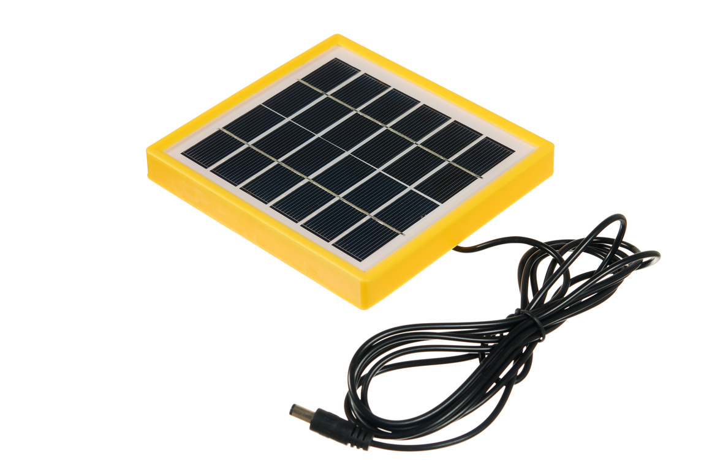
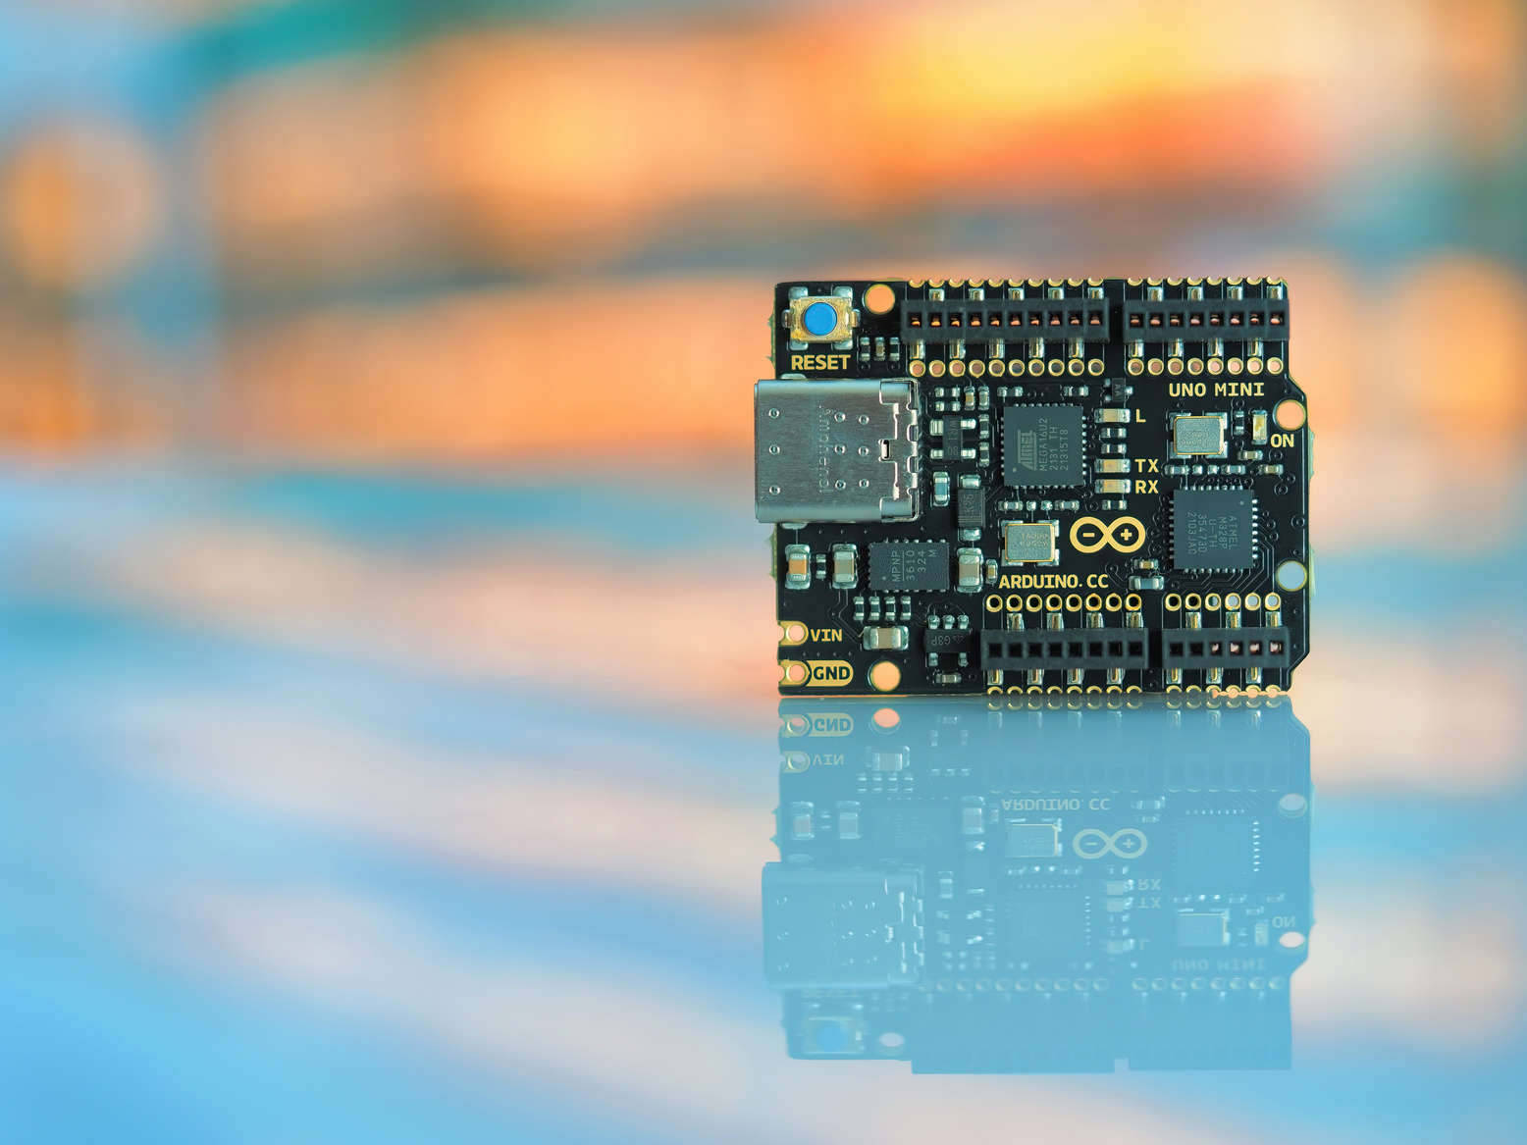
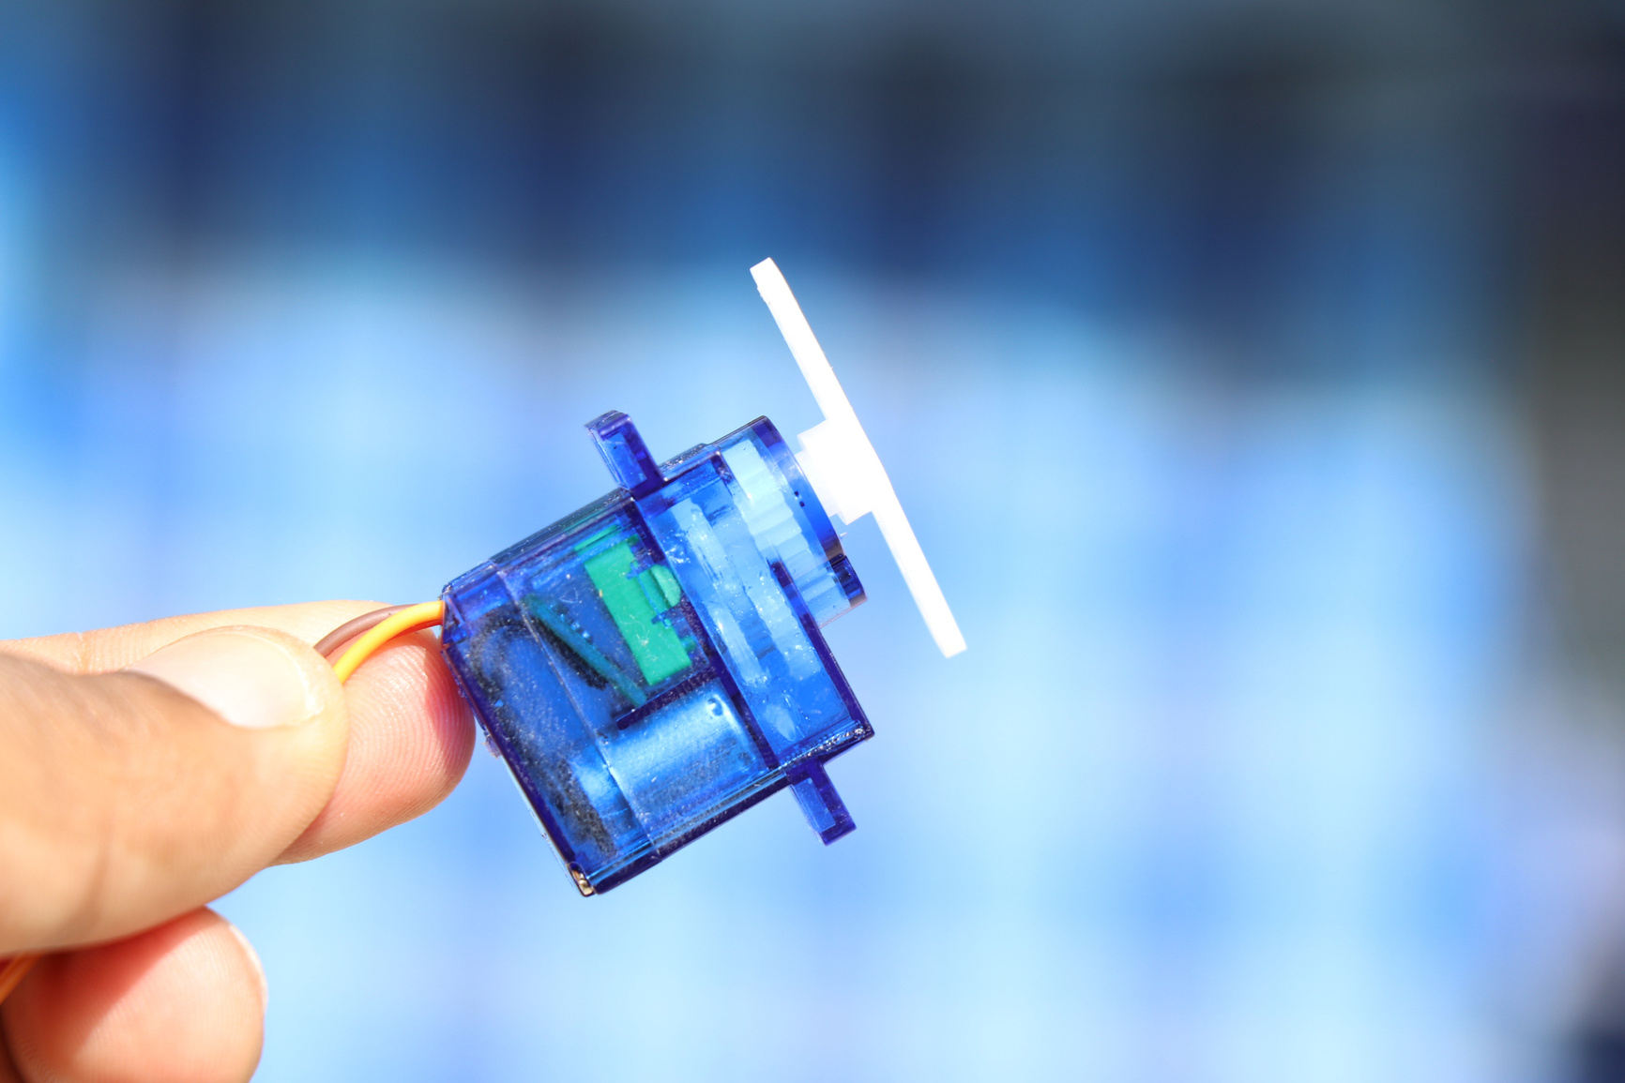
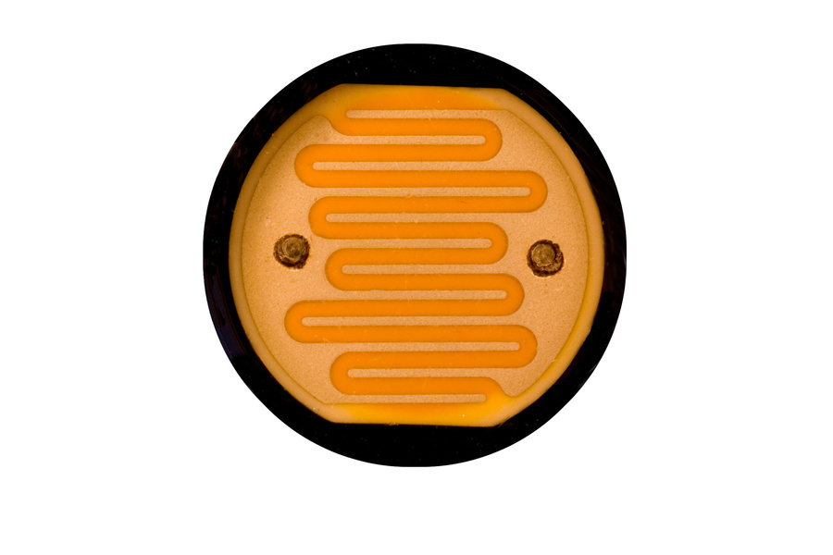
MINI SOLAR PANEL & UNO
Servo motor
LDR
Arduino Uno
Soler Panel
Registor

Slide 12

ADVANTAGES
DISADVANTAGES
SOLAR PROJECTS
SOLAR PROJECT
Simple
Low cost
Eco-Friendly
We can monitor directly using PC
Tracking accuracy is more
Reduce the usage of power from power grid
Storage or complimentary power system is required.
Limited power density.
Must be converted to AC when used in currently existing distribution grids

Slide 13
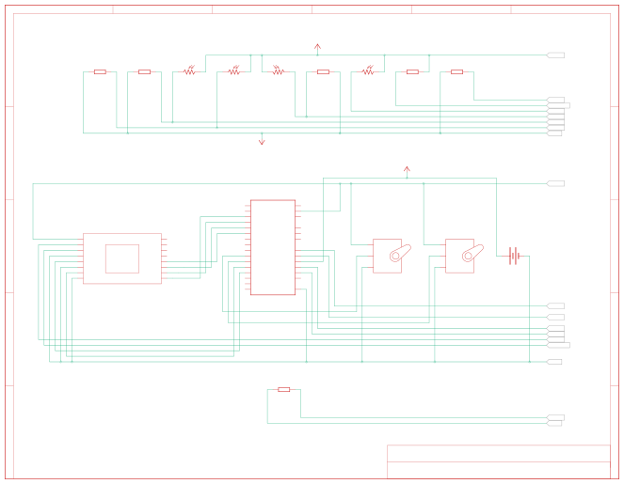
1
2
3
4
5
6
U2_5V
A
R9 10k
R8 10k
R7 10k
R2 1k
R1 1k
U2_5V
A
R6
R5
R4
R3
U1_VO U1_LED+ U2_A1 U2_A3 U2_A0 U2_A4 SC1-
B
SC1-
B
SC1+
U2
U2_5V
RX TX D2 D3 D4 D5 D6 D7 D8 D9 D10 D11 D12 D13 SDA SCL
VIN 5V 3.3V
VCC VO LED+ LED- RS RW ENA GND
U1
DB0 DB1 DB2 DB3 DB4 DB5 DB6 DB7
AREF IOREF RES
SERVO2
SERVO1
C
Arduino UNO
A0 A1 A2 A3 A4 A5
PWR
PWR
SC1
C
LCD 16x2
SIG
SIG
GND
GND
GND
U2_A0
U2_A1
D
U2_A3 U2_A4 U1_VO U1_LED+
D
SC1-
R10 10k
E
U2_A1 SC1-
E
Title: Date:12/28/2024, 4:48:16 AM
Project Solar
Made with Tinkercad®
Sheet:
1/1

Slide 14



